Slide 1
Lecture 10
Redundancy Removal Using ATPG
Redundancy identification
Redundancy removal

Slide 2
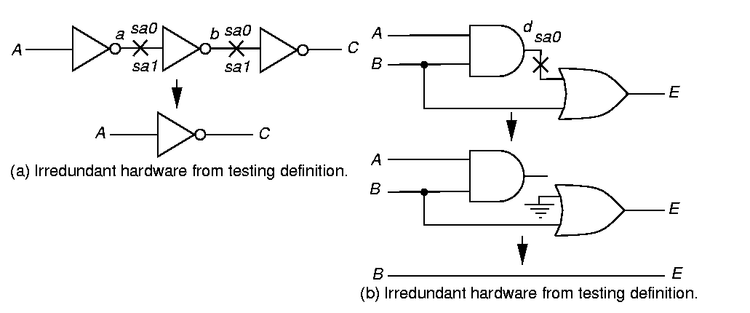
Irredundant Hardware and Test Patterns
Combinational ATPG can find redundant (unnecessary) hardware
Fault Test
a sa1, b sa0 A = 1
a sa0, b sa1 A = 0
Therefore, these faults are not redundant

Slide 3
Redundant Hardware and Simplification

Slide 4
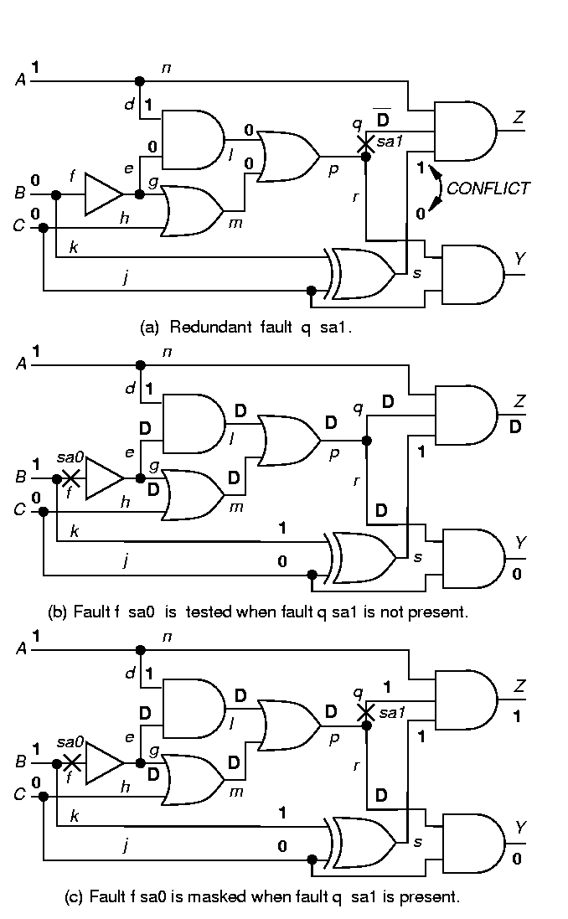
Redundant Fault q sa1

Slide 5
Multiple Fault Masking
f sa0 tested when fault q sa1 not there

Slide 6
Multiple Fault Masking
Part II
f sa0 masked when fault q sa1 also present

Slide 7
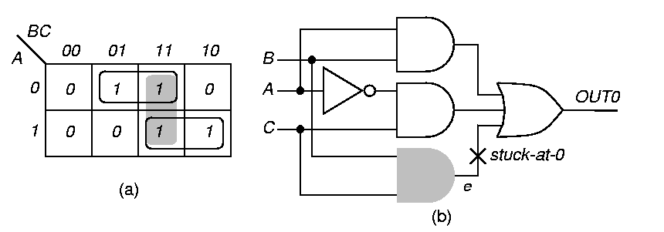
Intentional Redundant Implicant BC
Eliminates hazards in circuit output

Slide 8
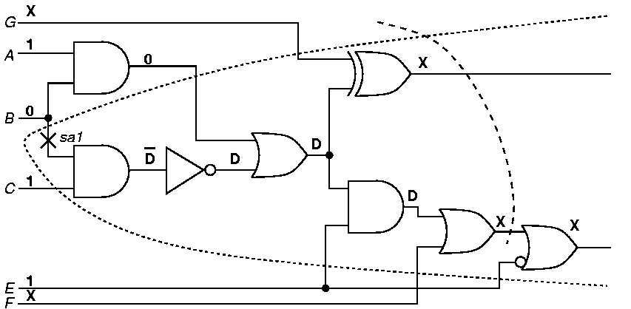
Fault Cone and D-frontier
Fault Cone -- Set of hardware affected by fault
D-frontier – Set of gates closest to POs with fault effect(s) at input(s)
D-frontier
Fault Cone

Slide 9
Algorithm 7.1
Redundancy Removal
Repeat until there are no more redundant faults:
  {
  Use ATPG to find all redundant faults;
  Remove all redundant faults with non-
  overlapping fault cone areas;
  }

